Slide 1

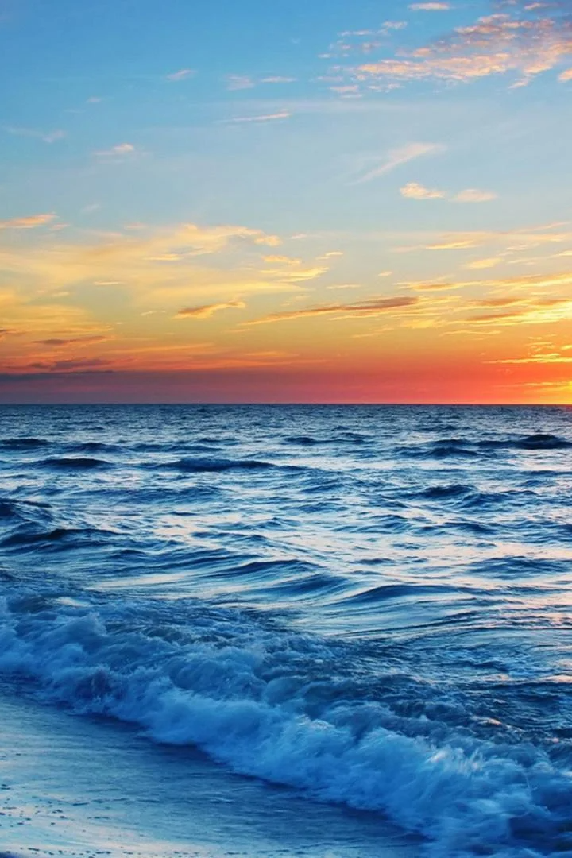

The Ocean
The ocean is a vast and mysterious body of water, covering more than 70% of the Earth's surface. It plays a crucial role in regulating climate and supporting a diverse range of life.
DJ
by David John

Slide 2
Importance of the Ocean
Climatic Regulation
Oxygen Production
The ocean absorbs and releases heat, helping to regulate the Earth's climate and weather patterns.
Through photosynthesis, marine plants produce over half of the world's oxygen supply.
Economic Value
Biodiversity
The ocean is a major source of food, energy, and resources, supporting industries such as fishing, tourism, and offshore energy production.
The ocean is home to millions of species, including unique and endangered ones, contributing to global biodiversity.

Slide 3

Fun Facts about the Ocean
1
Deep Sea Exploration
The Challenger Deep in the Mariana Trench is the deepest part of the ocean, reaching a depth of about 36,070 feet.
2
The Great Barrier Reef
Spanning over 2,300 kilometers, the Great Barrier Reef is the largest living structure on Earth, visible even from space.
3
Gigantic Creatures
The blue whale, the largest animal on the planet, can grow up to 100 feet long and weigh around 200 tons.
4
Unexplored Territory
More than 80% of the ocean remains unexplored, leaving room for countless discoveries and scientific breakthroughs.

Slide 4
Oceanography
Definition and Scope
Study Areas within Oceanography
Tools and Techniques
Oceanography is the study of the ocean, including its physical, chemical, and biological components.
Researchers use various tools such as satellites, underwater robots, and deep-sea submersibles to explore and collect data in the ocean.
Sub-disciplines of oceanography include marine biology, geological oceanography, physical oceanography, and chemical oceanography.

Slide 5
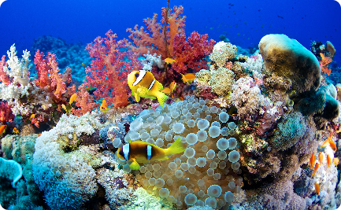
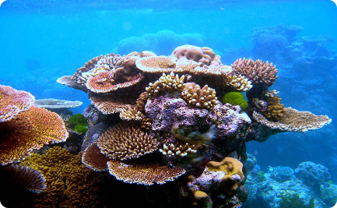
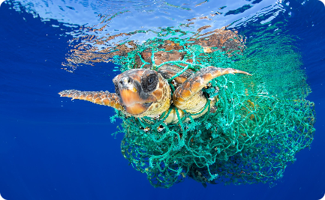
Ocean Ecosystems
Variety of Life in the Ocean
Coral Reefs and their Importance
Threats to Ocean Ecosystems
The ocean is teeming with life, ranging from microscopic plankton to majestic whales, showcasing incredible biodiversity.
Coral reefs support a vast array of marine species, protect coastlines from erosion, and provide livelihoods for coastal communities.
Pollution, overfishing, and climate change pose significant threats to the health and survival of ocean ecosystems.

Slide 6

Impact of Human Activity on the Ocean
1
Pollution and Plastic Waste
2
Overfishing and its Consequences
Plastic pollutants harm marine life, degrade water quality, and accumulate in massive oceanic garbage patches.
Unsustainable fishing practices deplete fish populations, disrupt marine food webs, and impact coastal economies.
3
Climate Change and Ocean Acidification
Rising temperatures and increasing CO2 levels lead to coral bleaching, altered habitats, and acidification, threatening marine ecosystems.

Slide 7
Conservation Efforts
1
Marine Protected Areas
Establishing protected areas helps conserve biodiversity, restore ecosystems, and sustainably manage ocean resources.
2
Sustainable Fishing Practices
Adopting responsible fishing methods reduces bycatch, protects vulnerable species, and promotes long-term fishery sustainability.
3
International Collaborations
Global initiatives and agreements, such as the Paris Agreement and the UN's Sustainable Development Goals, aim to address ocean-related challenges collectively.

Slide 8

Conclusion
The ocean is a complex and fragile ecosystem that we must protect and care for. Through responsible actions and concerted efforts, we can ensure a sustainable and vibrant future for our planet's most expansive and awe-inspiring natural wonder.

